Slide 1
Automatic Number Plate Recognition
By:
Nimisha Goel
Jaspreet Randhawa
Saiteja Prasadam

Slide 2
Introduction
Purpose: To detect the number plates in the given static images.
Basis: The detection is carried out on the basis of image processing.
Future Development uses:
Can be used in parking lot to charge the car.
Track stolen cars using network of cameras.
Automatically track individual car using network of cameras.
Charge the penalty to the car owner if the rules are broken.

Slide 3
Algorithms and Libraries used
KNN: Used for feature extraction and classification
OpenCV Library for Image Processing.
Test Data has been scrapped from the following link:
http://www.numberplates.com/pr-number-plate-gallery.asp?page=1

Slide 4
Steps Followed
Preprocessing
Train the KNN Classifier for character recognition.
The given image is converted into gray-scale for feature extraction.
Feature Extraction
Smoothing Image and extracting Threshold using GaussianBlur and adaptiveThreshold CV2 Functions.
With the threshold image we try to figure out all the possible areas of a number plate.

Slide 5
Steps Followed (Continued)
Classification
Identify actual number plate area from set of number plates extracted from “Feature Extraction”.
Perform KNN Classification on the identified number plate by segmenting each character and identifying them.
Post processing
We calculated the accuracy in this step, and we got 80.5% on a dataset of 1250 Images.

Slide 6
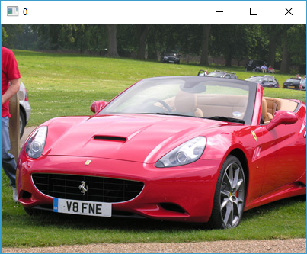
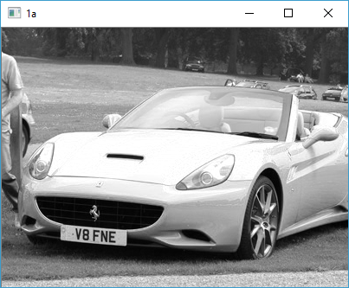
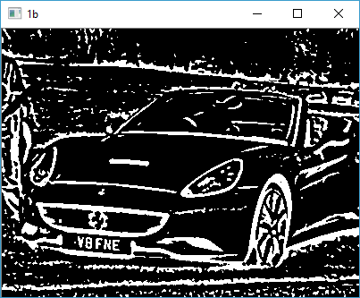
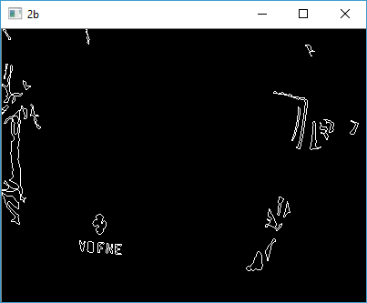
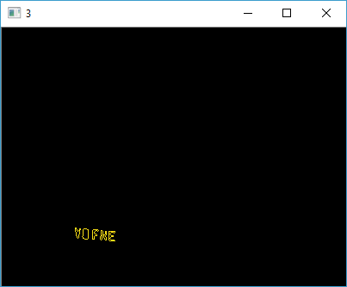
Steps Followed (Visuals)
Preprocessing
Feature extraction

Slide 7






Steps Followed (Visuals – Continued)
Classification

Slide 8
Conclusion
Extending this project can help to reduce manual labor on the large network of cameras in the city.
Can also extend to identify color, brand, model, type of the vehicle.

